Slide 1
Deep Generative Models for Semantic Text Hashing
Suthee Chaidaroon
PhD Candidate
March 3, 2020
Dissertation Advisor: Professor Yi Fang
Dissertation Committees:
Professor Tokunbo Ogunfumi, Silvia Figueria, Yuhong Liu, Ying Liu

Slide 2
Publications
Suthee Chaidaroon, and Yi Fang. "Variational deep semantic hashing for text documents." Proceedings of the 40th International ACM SIGIR Conference on Research and Development in Information Retrieval. 2017. Acceptance rate: 22% (78 out of 362)
Suthee Chaidaroon, Travis Ebesu, and Yi Fang. "Deep semantic text hashing with weak supervision." The 41st International ACM SIGIR Conference on Research & Development in Information Retrieval. 2018. Acceptance rate: 30% (98 out of 327)
Suthee Chaidaroon, Dae Hoon Park, Yi Chang, Yi Fang. “node2hash: Graph aware deep semantic text hashing.” Information Processing & Management, 2019. (Impact Factor: 3.892)
Suthee Chaidaroon, Yi Fang, Min Xie, and Alessandro Magnani. "Neural Compatibility Ranking for Text-based Fashion Matching." Proceedings of the 42nd International ACM SIGIR Conference on Research and Development in Information Retrieval. 2019. Acceptance rate: 24.4% (108 out of 443)
2

Slide 3
Overview
Motivation and Problem
Literature Studies and Related works
Unsupervised Text hashing model
Supervised Text hashing models
Unsupervised Text hashing with Weak supervision
Unsupervised Text hashing with Graph Context
Challenge and Future works
3
Notes:
Try to convince people to the contributions
What is new in the works
Show the connection of different models
Add the connection of the lowerbound
- log data likelihood
- variational lowerbound
- neural nets
transition of different models:
- relationship among different models
- focus the high-level stories
- ensure people understand the contributions.
focus on the contributions and novelty of the works
- missing the summary before talking about the future directions
- show the list of my own publications
- put a thank you slide
- make sure some figures are large
- put the page number on each slide
try to face the audiences
- try to convince that I deserve Phd degree.
try to screenshot only the equation.

Slide 4
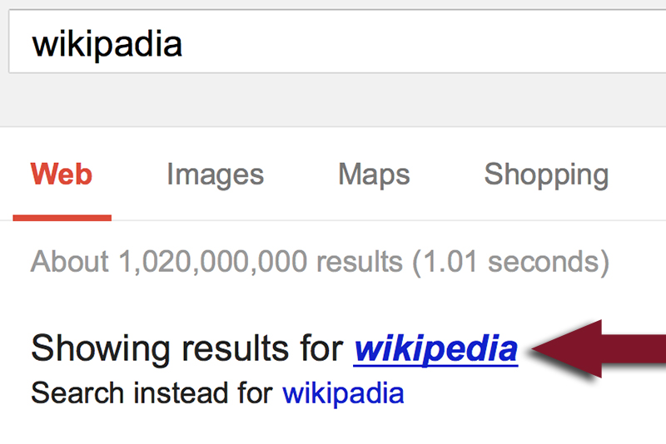
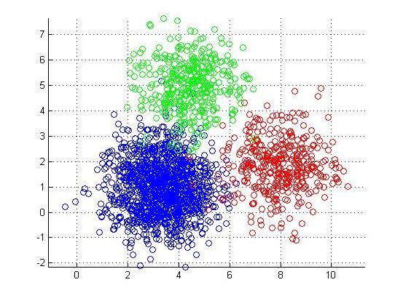
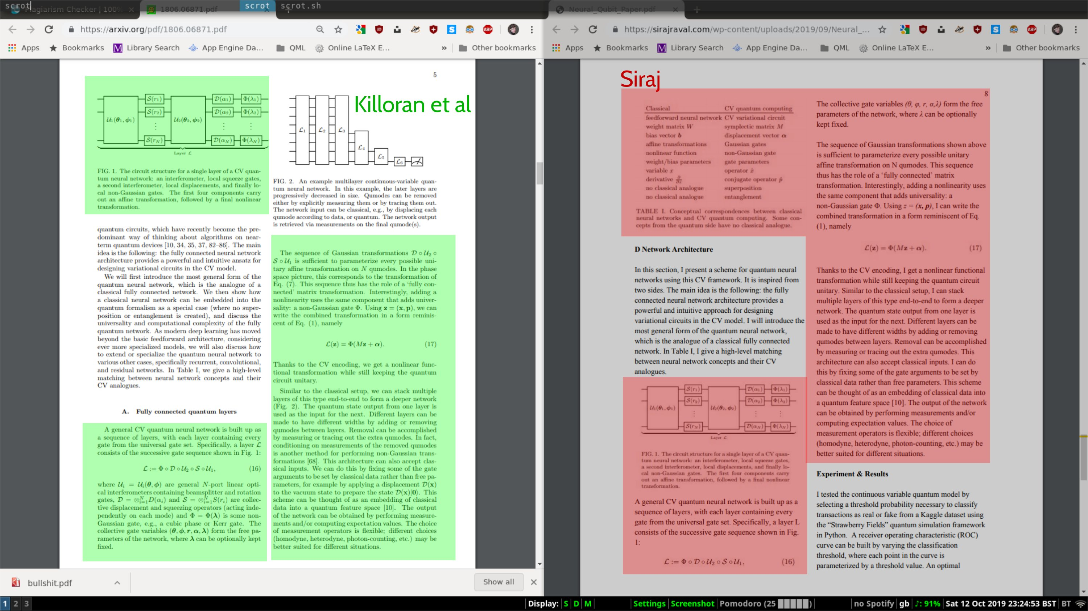
Text Similarity Search is Everywhere
A core task in many search problems and applications
Web search
Spell correction
Spell suggestion
Document retrieval
K-mean cluster
Near-Duplicate Detection
Plagiarism detection
School or Department, Arial 14 pt.
Notes:
Try to explain the problem and its applications

Slide 5
The size of text corpus in the era of big data
Amazon Reviews Dataset (35M reviews, 11GB)
Apache Software Foundation mail archives (~200GB)
Reddit Comments (1.7 billion comments, 250GB)
ArXiv (~270GB)
Google Book Ngrams (2.2TB)
Common Crawl (25 billion web pages, 541TB)
5
Notes:
Explain why performing text similarity search for big data is challenging
- As the size of the text corpus increases, we want text similarity search solution that needs less computational power and less storage.

Slide 6
Challenge of similarity search on big data
Limited computational resources
Limited storage capacity
6

Slide 7
Semantic Hashing
Fast similarity search technique
Maps a (text) data into a short binary vector.
The binary vector preserves semantic information of the input data.
Doc 1
Binary space
Doc 2
Doc 3
Doc 4
7

Slide 8
Advantage of semantic hashing
Use hamming distance to compute a distance between two binary vectors.
A few machine instructions (XOR + Bit counts)
Limited computational resources
Maps a text document into a short binary vector.
32, 64, or 128-bit vector
4, 8, 16 bytes per vector
Limited storage capacity
8

Slide 9
Literature Studies

Slide 10
Literature Studies
Space Partition Methods
PCA, LSH, SpH, STH
Topic Model
LSI, PLSA, LDA
Deep Learning as representation learning
Supervised learning
10

Slide 11
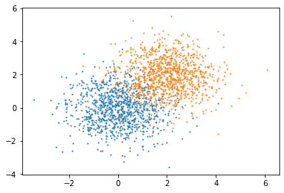
Space Partitioning Methods
PCA
LSH
Mayur Datar, Nicole Immorlica, Piotr Indyk, and Vahab S Mirrokni. Locality-sensitive hashing scheme based on p-stable distributions. InProceedings of thetwentieth annual symposium on Computational geometry, pages 253–262. ACM,2004.
11

Slide 12
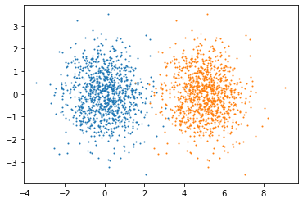
Space Partitioning Methods
SpH
STH
Zhang, Dell, et al. "Self-taught hashing for fast similarity search." Proceedings of the 33rd international ACM SIGIR conference on Research and development in information retrieval. 2010.
Weiss, Yair, Antonio Torralba, and Rob Fergus. "Spectral hashing." Advances in neural information processing systems. 2009.
12

Slide 13
Space Partitioning Methods
Intuitive and Explainable
Representing a document as a bag-of-words vector is suboptimal.
It is hard to separate data in this representation.
We need a better representation.
13

Slide 14
Topic Model
LSI [5]
$D=UΣV^{T}$
PLSA [6]
$P\left(w | d\right)=\sum_{z}{P\left(w | z\right)P\left(z | d\right)}$
LDA [7]
$P\left(w | β,θ\right)=\sum_{z}{P\left(w | z,β\right)P\left(z | θ\right)}$
M by N
K by K
K by N
$$≈$$
M by K
x
x
Scott Deerwester, Susan T Dumais, George W Furnas, Thomas K Landauer, andRichard Harshman. Indexing by latent semantic analysis.Journal of the Americansociety for information science, 41(6):391–407, 1990.
Thomas Hofmann. Probabilistic latent semantic indexing. InProceedings of the22nd annual international ACM SIGIR conference on Research and developmentin information retrieval, pages 50–57, 1999.
David M Blei. Probabilistic topic models.Communications of the ACM, 55(4):77–84, 2012.
14

Slide 15
Topic Model
Represent a text document as a topic distribution vector.
The vector is a low-dimensional vector.
The vector tends to be clustered together.
Use generative process to model the domain knowledges.
Compose complex distributions from simple distributions via a generative process.
But Sampling-based and EM-based parameter estimations are not scalable.
15

Slide 16
Deep Hashing
Use deep learning tool to learn a representation for image data
Most works are supervised learning models.
The neural networks tend to overfit the data.
There are not many works on text hashing.
16

Slide 17
What we have learned so far
Space Partition methods
When data are nicely grouped together, it is easy to partition the data into different groups.
Topic Model
This is an effective approach to reduce the size of the documents while maintain the semantic information.
Deep Learning
A powerful tool for learning a document representation.
17

Slide 18
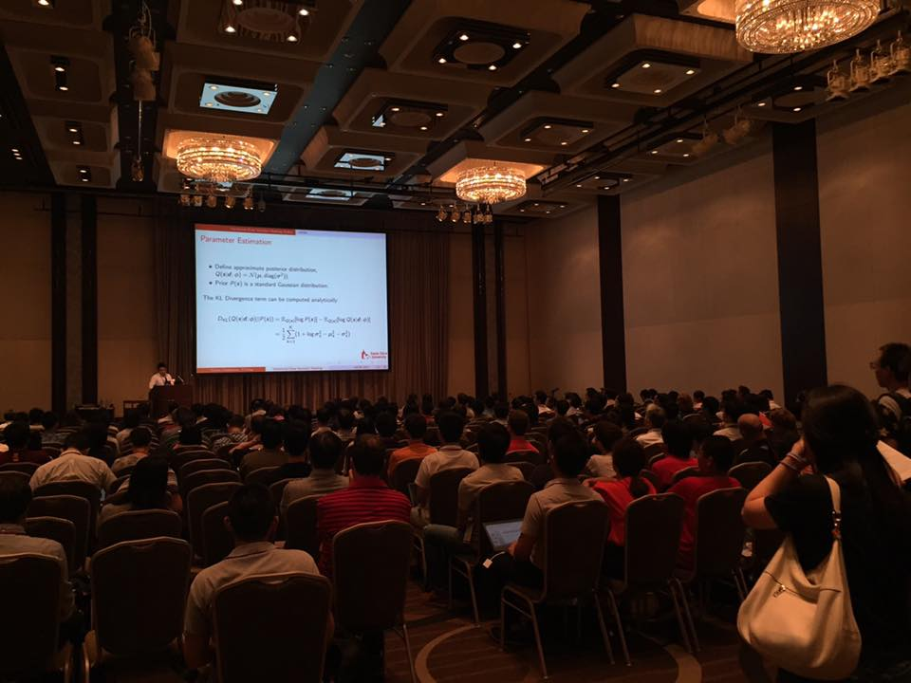
Research Contributions
I presented my first paper at SIGIR 2017
18

Slide 19
Research Overview
Unsupervised Semantic Text Hashing
Labels
VDSH
Document Connections
Document Distance
Supervised Text Hashing
Unsupervised Model with Weak Supervision
Unsupervised Model with Document Connections
VDSH-S
VDSH-SP
NbrReg
NbrReg+Doc
node2hash
19

Slide 20
Research Overview
Unsupervised Semantic Text Hashing
Labels
VDSH
Document Connections
Document Distance
Supervised Text Hashing
Unsupervised Model with Weak Supervision
Unsupervised Model with Document Connections
VDSH-S
VDSH-SP
NbrReg
NbrReg+Doc
node2hash
20

Slide 21
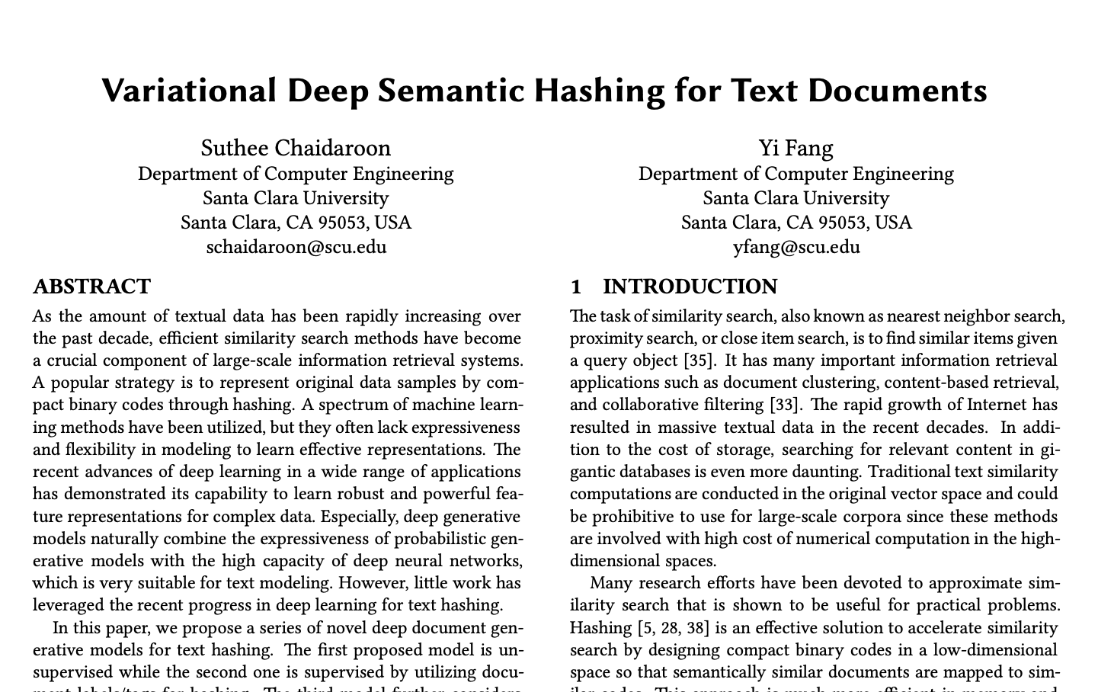

Slide 22
Contribution
This is the first semantic hashing model that models a text document generation via a deep generative formulation.
We derived a tractable objective function that can be translated into a deep neural networks.
The proposed semantic hashing models had achieved the state-of-the-arts performance on various public text datasets (2017).
22

Slide 23
Document Modeling
$$Normal(0,I)$$
Given text document d and its semantic vector s:
Model the relationship between d and s through a generative process
N is the number of words in d
M is the total text documents
Document Generative Process:
Draw semantic vector s from $P\left(s\right)=Normal\left(0, I\right)$
For the i-th word, $w_{i}$ in the document:
Draw $w_{i}∼P\left(w_{i}\right|f(s;θ))$
$P(w_{i}|f\left(s;θ\right))= \frac{exp⁡(w_{i}^{T}f(s;θ)}{\sum_{j=1}^{V}{exp⁡(w_{j}^{T}f\left(s;θ\right))}}$
$$s$$
$$w$$
$$N$$
$$M$$
23

Slide 24
Variational Lowerbound (1/2)
Given a joint distribution: $P\left(d,s\right)=P\left(d | s\right)P\left(s\right)$
We want to fit the document model to the given data.
$$P\left(d\right)=\int_{s}{P\left(d | s\right)P\left(s\right)ds}$$
$$\log{P\left(d\right)=\log{\int_{s}{P\left(d | s\right)P\left(s\right)ds}}}$$
$$=\log{\int_{s}{\frac{Q\left(s | d\right)}{Q\left(s | d\right)}P\left(d | s\right)P\left(s\right)ds=log\int_{s}{Q\left(s | d\right)[\frac{P\left(d | s\right)P\left(s\right)}{Q\left(s | d\right)}]ds}}}$$
$$≥\int_{s}{Q\left(s | d\right)\log\left(\frac{P\left(d | s\right)P\left(s\right)}{Q\left(s | d\right)}\right)ds}$$
This is hard to optimize due to the integration term
is inside log function.
Add proxy distribution Q(s|d)
Jensen’s inequality
24

Slide 25
Variational Lowerbound (2/2)
$$\log{P\left(d\right)}≥E_{Q(s|d)}[\log{P\left(d | s\right)+\log{P\left(s\right)−\log{Q\left(s | d\right)}]}}$$
$$=E_{Q(s|d)}[\log{P(d|s)]}−E_{Q\left(s | d\right)}[\frac{Q\left(s | d\right)}{P\left(s\right)}]$$
$$=E_{Q(s|d)}[\log{P(d|s)]} −KL(Q\left(s | d\right)||P\left(s\right))$$
Reconstruction Error
Regularization
How much information from d is in s?
How much difference between Q(s|d) and P(s)
25

Slide 26
Convert to Deep Learning model
We will convert the variational lowerbound into a deep neural network.
$$LL\left(d\right)=E_{Q(s|d)}[\log{P(d|s)]} −KL(Q\left(s | d\right)||P\left(s\right))$$
$$≈\frac{1}{K}\sum_{k=1}^{K}{\log{P\left(d | s^{\left(k\right)}\right)}}$$
Where
$$s^{(k)}∼Q(s|d)$$
$$Q\left(s | d\right)=Normal\left(μ\left(d;θ\right), σ\left(d;θ\right)\right)$$
$$P\left(s\right)=Normal(0, I)$$
$s=ε∗σ\left(d;θ\right)+μ\left(d;θ\right)$
where $ε∼Normal(0,1)$
Neural Networks
26

Slide 27
Model Architecture
Variational Deep Semantic Hashing model (VDSH)

Slide 28
Quantization
The model learns the $Q\left(s | d\right)$ to generate semantic vector $s$.
But $s$ is a continuous vector.
We need to quantize the semantic vector to binary hash code.
Use the maximum entropy principle to balance partitioning of the dataset.
Threshold of $p^{th}$ bit is the median of the $p^{th}$dimension of $s$in the training data.
s1=[0.1, -3.5, 12.4]
s2=[0.2, 4.5, 10.1]
b1=[0, 0, 1]
b2=[1, 1, 0]
threshold=[0.15, 0.2, 10]
28

Slide 29
Evaluation
Binary space
Split data into train and test set
Encode train data into hash codes
Encode test data into hash codes
Pick K-nearest training data.
Compute the precision at K
# of relevant documents / K
We use a document label as a relevant signal.
1
Train
3
2
Test
29

Slide 30
Evaluation Results
RCV1
800K documents, 103 classes, multi-labeled.
Methods | 8-bits | 16-bits | 32-bits | 64-bits | 128-bits
LSH [1] | 0.4180 | 0.4352 | 0.4716 | 0.5214 | 0.5877
SpH [2] | 0.5093 | 0.7121 | 0.7475 | 0.7559 | 0.7423
STHs [3] | 0.3975 | 0.4898 | 0.5592 | 0.5945 | 0.5946
RBMs [4] | 0.5106 | 0.5743 | 0.6130 | 0.6463 | 0.6531
VDSH | 0.7976 | 0.7944 | 0.8481 | 0.8951 | 0.8444
% Improved | 56.21% | 11.56% | 13.46% | 18.42% | 13.75%
Precision at 100
30

Slide 31
Evaluation Results
Reuters
10,788 documents, 90 categories, multi-labeled.
Methods | 8-bits | 16-bits | 32-bits | 64-bits | 128-bits
LSH [1] | 0.2802 | 0.3215 | 0.3862 | 0.4667 | 0.5194
SpH [2] | 0.6080 | 0.6340 | 0.6513 | 0.6290 | 0.6045
STHs [3] | 0.6616 | 0.7351 | 0.7554 | 0.7350 | 0.6986
RBMs [4] | 0.5113 | 0.5740 | 0.6154 | 0.6177 | 0.6452
VDSH | 0.6859 | 0.7165 | 0.7753 | 0.7456 | 0.7318
% Improved | 3.67% | -2.53% | 2.63% | 1.44% | 4.75%
Precision at 100
31

Slide 32
Evaluation Results
20Newsgroups
18,828 documents, 20 categories, single-labeled.
Methods | 8-bits | 16-bits | 32-bits | 64-bits | 128-bits
LSH [1] | 0.0533 | 0.0558 | 0.0587 | 0.0635 | 0.0720
SpH [2] | 0.0548 | 0.0567 | 0.0896 | 0.1286 | 0.1218
STHs [3] | 0.2337 | 0.3415 | 0.3885 | 0.4070 | 0.3743
RBMs [4] | 0.0594 | 0.0604 | 0.0533 | 0.0623 | 0.0642
VDSH | 0.2905 | 0.3125 | 0.3346 | 0.3364 | 0.3874
% Improved | 24.30% | -8.49% | -13.87% | -17.35% | 3.50%
Precision at 100
32

Slide 33
Evaluation Results
TMC
21,519 documents, 20 categories, single-labeled.
Methods | 8-bits | 16-bits | 32-bits | 64-bits | 128-bits
LSH [1] | 0.4388 | 0.4393 | 0.4514 | 0.4553 | 0.4773
SpH [2] | 0.5807 | 0.6055 | 0.6281 | 0.6143 | 0.5891
STHs [3] | 0.3720 | 0.3947 | 0.4105 | 0.4181 | 0.4123
RBMs [4] | 0.4846 | 0.5108 | 0.5166 | 0.5190 | 0.5137
VDSH | 0.4330 | 0.6853 | 0.7108 | 0.7221 | 0.7247
% Improved | -25.43% | 13.18% | 13.17% | 17.55% | 23.02%
Precision at 100
33

Slide 34
Research Overview
Unsupervised Semantic Text Hashing
Labels
VDSH
Document Connections
Document Distance
Supervised Text Hashing
Unsupervised Model with Weak Supervision
Unsupervised Model with Document Connections
VDSH-S
VDSH-SP
NbrReg
NbrReg+Doc
node2hash
34

Slide 35
Supervised Learning Models (VDSH-S)
Document content similarity alone may not reflect the semantic relationship.
Labels or tags provide useful guidance in learning hash codes.
Documents in the same category could have a high semantic similarity.
Are they semantically related?
Pregnancy dress
I book a hotel room.
Pregnancy dress
clothing
I book a hotel room.
travel
Maternity gown
Harry Potter book.
Maternity gown
clothing
Harry Potter book.
novel
35

Slide 36
Document Modeling (VDSH-S)
$$Normal(0,I)$$
Given text document d, semantic vector s, and label y:
Document Generative Process:
Draw semantic vector s from $P\left(s\right)=Normal\left(0, I\right)$
For the i-th word, $w_{i}$ in the document:
Draw $w_{i}∼P\left(w_{i}\right|f(s;θ))$
$P(w_{i}|f\left(s;θ\right)= \frac{exp⁡(w_{i}^{T}f(s;θ)}{\sum_{j=1}^{V}{exp⁡(w_{j}^{T}f\left(s;θ\right))}}$
For the j-th label in the label set:
Draw $y_{j}∼P\left(y | f\left(s;τ\right)\right)$
$P\left(y_{i} | f\left(s;τ\right)\right)=σ(y_{j}^{T}f\left(s;τ\right))$ for multiple labels/tags.
$P\left(y_{i} | f\left(s;τ\right)\right)=\frac{exp⁡(y_{i}^{T}f(s;τ)}{\sum_{j=1}^{L}{exp⁡(y_{j}^{T}f\left(s;τ\right))}}$ for a single label.
$$s$$
$$w$$
$$y$$
$$N$$
$$L$$
$$M$$
36

Slide 37
Variational Lowerbound
$$P\left(d,y\right)=\int_{s}{P\left(d | s\right)P\left(y | s\right)P\left(s\right)ds}$$
$$≥E_{Q\left(s | d\right)}[\log{P(d|s)]}+E_{Q\left(s | d\right)}[\log{P(y|s)]}−KL(Q(s|d)||P\left(s\right))$$
Reconstruction Error
Classification Error
Regularization
37

Slide 38
Model Architecture
Supervised Model (VDSH-S)

Slide 39
Document-specific Modeling (VDSH-SP)
The original document may contain information that is irrelevant to the labels.
The model adds two variables:
Shared variable that shared information between document and labels.
Private variable contains content that is irrelevant to the labels.
39

Slide 40
Private Document Modeling (VDSH-SP)
$$Normal(0,I)$$
$$Normal(0,I)$$
Given text document d, semantic vector s and v, and label y:
Document Generative Process:
Draw semantic vector s from $P\left(s\right)=Normal\left(0, I\right)$
Draw semantic vector v from $P\left(v\right)=Normal\left(0, I\right)$
For the i-th word, $w_{i}$ in the document:
Draw $w_{i}∼P\left(w_{i}\right|f(s+v;θ))$
$P(w_{i}|f\left(s+v;θ\right)= \frac{exp⁡(w_{i}^{T}f\left(s+v;θ\right))}{\sum_{j=1}^{V}{exp⁡(w_{j}^{T}f\left(s+v;θ\right))}}$
For the j-th label in the label set:
Draw $y_{j}∼P\left(y | f\left(s;τ\right)\right)$
$P\left(y_{i} | f\left(s;τ\right)\right)=σ(y_{j}^{T}f\left(s;τ\right))$ for multiple labels/tags.
$P\left(y_{i} | f\left(s;τ\right)\right)=\frac{exp⁡(y_{i}^{T}f\left(s;τ\right))}{\sum_{j=1}^{L}{exp⁡(y_{j}^{T}f\left(s;τ\right))}}$ for a single label.
$$v$$
$$s$$
$$w$$
$$y$$
$$N$$
$$L$$
$$M$$
40

Slide 41
Variational Lowerbound
$$\log{P(d,y)}=\int_{s,v}{P\left(d | s,v\right)P\left(y | s\right)P\left(s\right)dsdv}$$
$$≥\int_{s,v}{Q\left(s,v | d\right)}[\log{P\left(d | s,v\right)+\log{P(y|s)}+\log{P(s)}−\log{Q(s,v|d)]}}$$
$$≥E_{Q\left(s,v | d\right)}[\log{P(d|s,v)]}+E_{Q\left(s,v | d\right)}[\log{P(y|s)]}−KL(Q(s|d)||P\left(s\right)) −KL(Q(v|d)||P\left(v\right))$$
Reconstruction Error
Classification Error
Regularization
41

Slide 42
Model Architecture
Supervised Private Document Model (VDSH-SP)

Slide 43
Evaluation Results
RCV1
800K documents, 103 classes, multi-labeled.
Methods | 8-bits | 16-bits | 32-bits | 64-bits | 128-bits
VDSH | 0.7976 | 0.6853 | 0.7108 | 0.7221 | 0.7247
KSH [5] | 0.9126 | 0.9146 | 0.9221 | 0.9333 | 0.9350
SHTTM [6] | 0.8829 | 0.9038 | 0.9258 | 0.9459 | 0.9447
VDSH-S | 0.9652 | 0.9749 | 0.9801 | 0.9804 | 0.9800
VDSH-SP | 0.9666 | 0.9757 | 0.9788 | 0.9805 | 0.9794
% Improved (VDSH-S) | 5.76% | 6.59% | 5.87% | 3.65% | 3.74%
% Improved (VDSH-SP) | 5.92% | 6.68% | 5.72% | 3.66% | 3.67%
Precision at 100
43

Slide 44
Evaluation Results
Reuters
10,788 documents, 90 categories, multi-labeled.
Methods | 8-bits | 16-bits | 32-bits | 64-bits | 128-bits
VDSH | 0.6859 | 0.7165 | 0.7753 | 0.7456 | 0.7318
KSH [5] | 0.7840 | 0.8376 | 0.8480 | 0.8537 | 0.8620
SHTTM [6] | 0.7992 | 0.8520 | 0.8323 | 0.8271 | 0.8150
VDSH-S | 0.9005 | 0.9121 | 0.9337 | 0.9407 | 0.9299
VDSH-SP | 0.8890 | 0.9326 | 0.9283 | 0.9286 | 0.9395
% Improved (VDSH-S) | 12.68% | 7.05% | 10.11% | 10.19% | 7.88%
% Improved (VDSH-SP) | 11.24% | 9.46% | 9.47% | 8.77% | 8.99%
Precision at 100
44

Slide 45
Evaluation Results
20Newsgroups
18,828 documents, 20 categories, single-labeled.
Methods | 8-bits | 16-bits | 32-bits | 64-bits | 128-bits
VDSH | 0.2905 | 0.3125 | 0.3346 | 0.3364 | 0.3874
KSH [5] | 0.4257 | 0.5559 | 0.6103 | 0.6488 | 0.6638
SHTTM [6] | 0.2690 | 0.3235 | 0.2357 | 0.1411 | 0.1299
VDSH-S | 0.6586 | 0.6791 | 0.7564 | 0.6850 | 0.6919
VDSH-SP | 0.6609 | 0.6551 | 0.7125 | 0.7045 | 0.7117
% Improved (VDSH-S) | 54.71% | 22.16% | 23.94% | 5.58% | 4.23%
% Improved (VDSH-SP) | 55.25% | 17.84% | 16.75% | 8.59% | 7.22%
Precision at 100
45

Slide 46
Evaluation Results
TMC
21,519 documents, 20 categories, single-labeled.
Methods | 8-bits | 16-bits | 32-bits | 64-bits | 128-bits
VDSH | 0.4333 | 0.6853 | 0.7108 | 0.7221 | 0.7247
KSH [5] | 0.6608 | 0.6842 | 0.7047 | 0.7175 | 0.7243
SHTTM [6] | 0.6299 | 0.6571 | 0.6485 | 0.6893 | 0.6474
VDSH-S | 0.7387 | 0.7887 | 0.7883 | 0.7967 | 0.8018
VDSH-SP | 0.7498 | 0.7798 | 0.7891 | 0.7888 | 0.7970
% Improved (VDSH-S) | 11.79% | 15.09% | 10.90% | 10.33% | 10.64%
% Improved (VDSH-SP) | 13.47% | 13.79% | 11.02% | 9.24% | 9.98%
Precision at 100
46

Slide 47
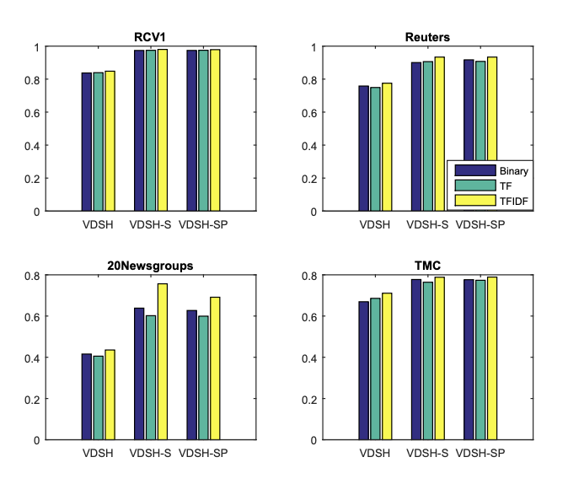
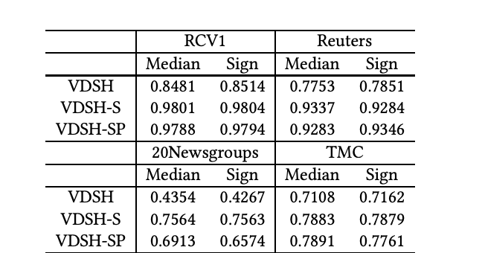
Preprocessing and Thresholding
Precision@100 for different term weighting schemes.
Precision@100 of using different thresholding functions.
47

Slide 48
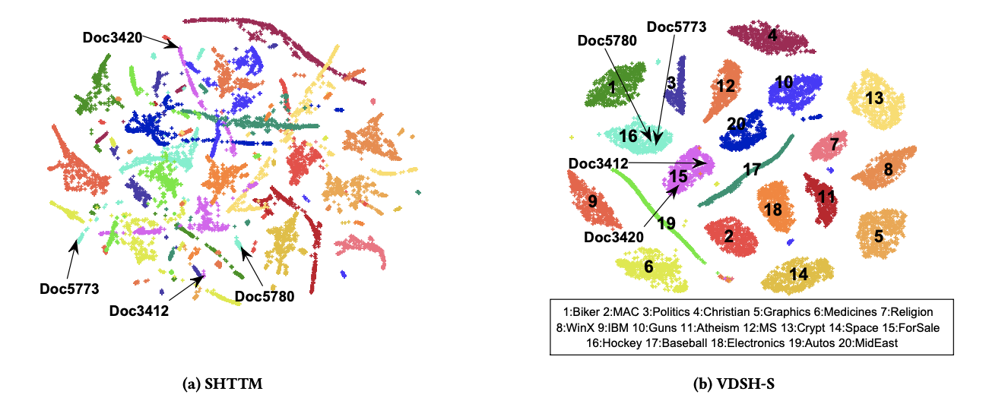
Qualitative Analysis
48

Slide 49
Summary
We purpose a series of deep generative models for text hashing.
The models takes advantages of both deep learning and probabilistic generative models.
The models significantly outperform the competitive baselines on four public testbeds.
49

Slide 50
Research Overview
Unsupervised Semantic Text Hashing
Labels
VDSH
Document Connections
Document Distance
Supervised Text Hashing
Unsupervised Model with Weak Supervision
Unsupervised Model with Document Connections
VDSH-S
VDSH-SP
NbrReg
NbrReg+Doc
node2hash
50

Slide 51
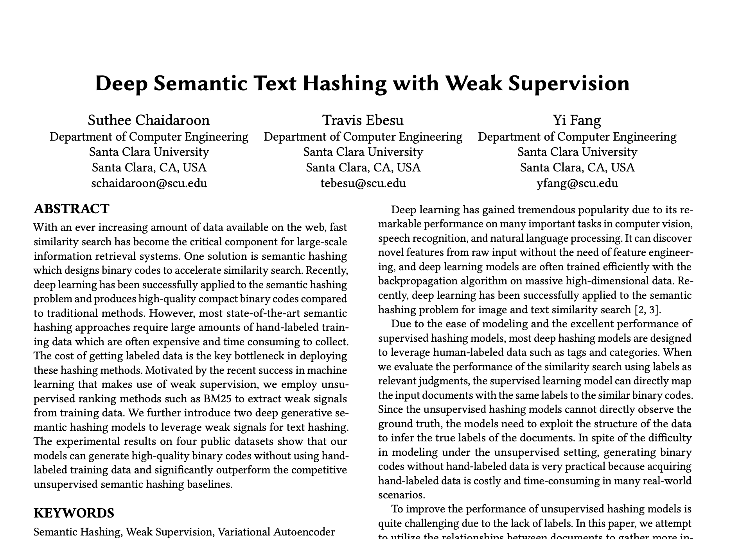

Slide 52
Motivations
Supervised learning models are efficient but need a lot of labeled data.
Obtain labeled data is expensive especially for a large corpus.
Can we improve the unsupervised learning model (VDSH) without relying on labeled data?
https://www.nytimes.com/2018/11/25/business/china-artificial-intelligence-labeling.html

Slide 53
Solution
If both document share many words, they are likely to be semantically similar.
We use unsupervised ranking methods such as Okapi BM25 to find K-nearest documents.
$bm{25}_{score\left(D,Q\right)}=\sum_{i=1}^{n}{IDF\left(q_{i}\right)⋅[\frac{f\left(q_{i}, D\right)⋅\left(k_{1}+1\right)}{f\left(q_{i},D\right)+k_{1}⋅\left(1−b+b⋅\frac{\left|D\right|}{avgdl}\right)}]}$
We use the K-nearest documents to generate a better binary code.
Query Doc
Get Top K
1st Doc
Train Corpus
Query Doc
Our Proposed Models
BM25
2nd Doc
Hash code
3rd Doc
53

Slide 54
Top-K Documents are useful
The top-K documents are not drawn randomly.
The top-K documents are not always semantically similar.
Weak Supervision
Dataset | # of classes | BM25 | Random Sampling
DBPedia | 14 | 0.734 | 0.071
Yahoo Answers | 10 | 0.423 | 0.100
20Newsgroups | 20 | 0.326 | 0.050
AgNews | 4 | 0.755 | 0.250
Precision at 100
54

Slide 55
Neighbor Document Modeling
$$Normal(0,I)$$
Given text document d, semantic vector s, and label y:
Document Generative Process:
Draw semantic vector s from $P\left(s\right)=Normal\left(0, I\right)$
For the i-th word, $w_{i}$ in the document:
Draw $w_{i}∼P_{A}\left(w_{i}\right|f(s;θ))$
$P_{A}(w_{i}|f\left(s;θ\right)= \frac{exp⁡(w_{i}^{T}f\left(s;θ\right))}{\sum_{j=1}^{V}{exp⁡(w_{j}^{T}f\left(s;θ\right))}}$
For unique j-th word in the neighborhood set $NN(d)$:
Draw ${ w}_{j}^{′}∼P_{B}\left(w_{j}^{′} | f\left(s;θ\right)\right)$
$P_{B}(w_{j}^{′}|f\left(s;θ\right))= \frac{exp⁡({w^{′}}_{j}^{T}f\left(s;θ\right))}{\sum_{l=1}^{V}{exp⁡({w^{′}}_{l}^{T}f\left(s;θ\right))}}$
$$s$$
$$w$$
$$w^{′}$$
$$N$$
$$N^{′}$$
$$M$$
55

Slide 56
Variational Lowerbound
$$P\left(d,NN(d)\right)=\int_{s}{P\left(d | s\right)P\left(NN(d) | s\right)P\left(s\right)ds}$$
$$≥E_{Q\left(s | d\right)}[\log{P(d|s)]}+E_{Q\left(s | d\right)}[\log{P(NN(d)|s)]}−KL(Q(s|d)||P\left(s\right))$$
Reconstruction Error
Neighborhood
Reconstruction Error
Regularization
56

Slide 57
Model Architecture
Neighborhood Recognition Model (NbrReg)
57

Slide 58
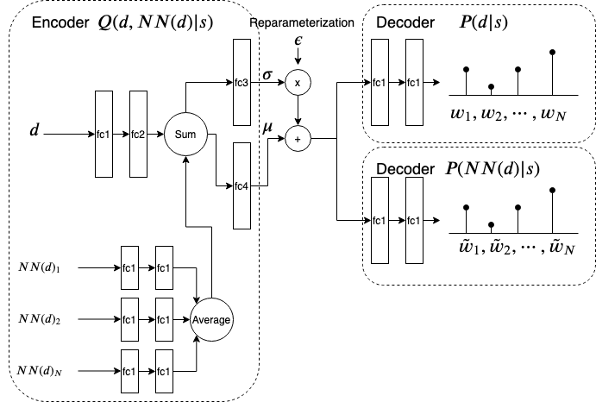
NbrReg+Doc
NbrReg+Doc Architecture
58

Slide 59
Experiment Setup
Datasets
Yahoo Answers (10 categories, 207,261 documents)
AG’s news (4 categories, 132,912 documents)
DBPedia (14 classes, 107,559 documents)
20Newsgroups (20 categories, 18K documents)
Baselines
LSH, SpH, LCH, STH
VDSH
59

Slide 60
Experimental Results
Precision at 100
60

Slide 61
Summary
We propose two deep generative models for text hashing by utilizing weak signals.
An unsupervised ranking model such as BM25 is used as weak signals.
The experimental results demonstrate that our models can leverage these signals and outperform the unsupervised text hashing baselines.
61

Slide 62
Research Overview
Unsupervised Semantic Text Hashing
Labels
VDSH
Document Connections
Document Distance
Supervised Text Hashing
Unsupervised Model with Weak Supervision
Unsupervised Model with Document Connections
VDSH-S
VDSH-SP
NbrReg
NbrReg+Doc
node2hash
62

Slide 63
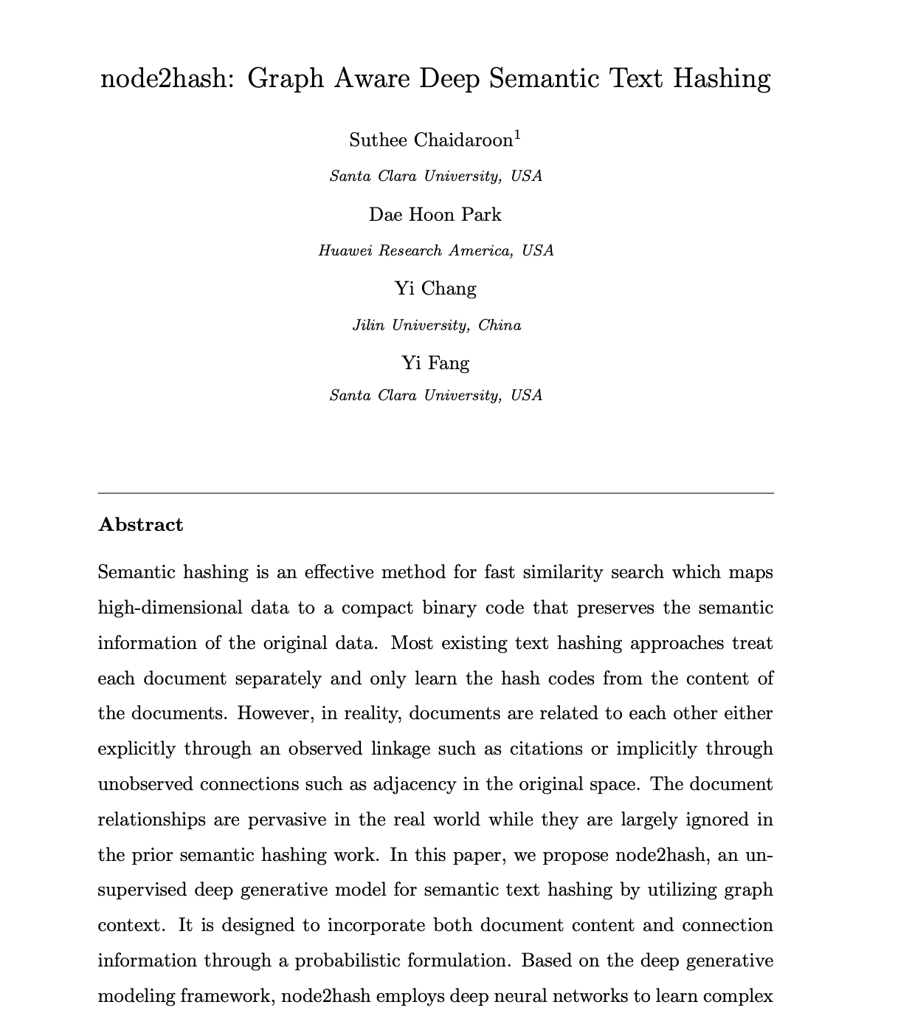

Slide 64
Motivation
The previous work uses BM25 algorithm to find the related documents.
Based on BM25 algorithm, documents are related based on word co-occurrence.
Doc C
Doc A
Can we use different information
to find the related documents?
Doc B
Doc D
Doc E
64

Slide 65
Document Connections
Citation networks
User Community
Paper 1
Paper 2
Post 3
Post 6
Paper 5
Post 1
Paper 3
Post 4
Post 2
Paper 4
Paper 6
Post 5
Posts are connected if the same users
comments on both posts.
Citing and Cited papers are related.
65

Slide 66
Contribution
We propose a graph-aware deep text hashing model, called node2hash.
This is unsupervised test hashing method that combines generative models and deep learning.
The model is applicable to a wide range of applications and datasets.
Explicit connections
Implicit connections
66

Slide 67
Connection Model
$$Normal(0,I)$$
Given text document d, semantic vector s, and label y:
Document Generative Process:
Draw semantic vector s from $P\left(s\right)=Normal\left(0, I\right)$
For the i-th word, $w_{i}$ in the document:
Draw $w_{i}∼P_{A}\left(w_{i}\right|f(s;θ))$
$P(w_{i}|f\left(s;θ\right)= \frac{exp⁡(w_{i}^{T}f\left(s;θ\right))}{\sum_{j=1}^{V}{exp⁡(w_{j}^{T}f\left(s;θ\right))}}$
For each neighbor of the document:
Draw the ID of the $j^{th}$ neighbor document, $a_{j}$ from neighbor distribution $P\left(a_{j} | s\right)$
$P(a_{j}|s)= \frac{exp⁡(q_{i}^{T}s+c_{i})}{\sum_{j}^{L}{\exp\left(q_{j}^{T}s+c_{j}\right)}}$
$$s$$
$$w$$
$$a$$
$$N$$
$$L$$
$$M$$
67

Slide 68
Neighborhood Sampling
Any document that is only 1-hop away from the input document is probably more similar than the document which is 2-hop or 3-hop away.
Depth First Search (DFS)
Capture the global structure of the graph
Breadth First Search (BFS)
Capture the local structure of the graph
Random-Walk
Attempt to balance between DFS and BFS
Paper 1
Paper 2
Paper 5
Paper 3
Paper 4
Paper 6
68

Slide 69
Variational Lowerbound
$$P\left(d,Nbr(d)\right)=\int_{s}{P\left(d | s\right)P\left(Nbr(d) | s\right)P\left(s\right)ds}$$
$$≥E_{Q\left(s | d\right)}[\log{P(d|s)]}+E_{Q\left(s | d\right)}[\log{P(Nbr(d)|s)]}−KL(Q(s|d)||P\left(s\right))$$
Reconstruction Error
Connection
Reconstruction Error
Regularization
69

Slide 70
Model Architecture
Node2hash model

Slide 71
Experimental Setup
Statistics of the datasets
71

Slide 72
Experimental Results
Precision at 100
72

Slide 73
Experimental Results
Precision at 100
73

Slide 74
Experimental Results
Precision at 100
74

Slide 75
Neighborhood Sampling Methods
Precision at 100 with 32-bit hash code
75

Slide 76
Qualitative Analysis
Visualization of the 32-bit hash codes by STH+Graph, VDSH, and node2hash
On he Pubmed dataset using t-SNE.
76

Slide 77
Summary
Node2hash seamlessly integrates both document content and connections, allows two sources of information to reinforce each other.
Node2hash uses generative process to encode unseen documents that have no connections with the existing training documents.
The deep neural networks are embedded in the model so that non-linear complex hash functions can be learned.
Node2hash significantly outperforms the competitive baselines.
77

Slide 78
Current Challenge and Future Directions

Slide 79
Challenge and Future Directions
End-to-End training
The encoder function and quantization are not trained jointly.
The model does not learn binary codes directly.
Semantic hashing for an ad-hoc search
Ad-hoc search in the industry still depends on text-matching and revert-index to retrieve the top documents.
Semantic hashing could be used for search in the production environment where scalability and speed are critical.
79

Slide 80
Evaluation protocol
Currently, we use document labels as a relevant signal.
Some may argue that any text classifier can also achieve the best performance.
We may need to use different evaluation methods
Use crowdsourcing to evaluate the top retrieved items by the models.
Investigate existing semantic hashing models on the new evaluation methods.
80

Slide 81
Summary
The work at SIGIR2017 is the first semantic hashing model that models a text document generation via a deep generative formulation.
We derived a tractable objective function that can be translated into a deep neural networks.
The proposed semantic hashing models had achieved the state-of-the-arts performance on various public text datasets.
The SIGIR2018 paper is the first semantic hashing model that utilizes a weak signal to overcome the lack of labeled data and achieve the best performance on the document retrieval task.
The node2hash model utilizes graph-context and abundant auxiliary information for text hashing and achieve the state-of-the-arts performance compared with the competitive unsupervised baselines.

Slide 82
Thank you
Prof. Yi Fang
The best advisor and mentor.
The thesis committees

Slide 83
References
Wang, Qifan, Dan Zhang, and Luo Si. "Semantic hashing using tags and topic modeling." Proceedings of the 36th international ACM SIGIR conference on Research and development in information retrieval. 2013.
Zhang, Dell, et al. "Self-taught hashing for fast similarity search." Proceedings of the 33rd international ACM SIGIR conference on Research and development in information retrieval. 2010.
Weiss, Yair, Antonio Torralba, and Rob Fergus. "Spectral hashing." Advances in neural information processing systems. 2009.
Salakhutdinov, Ruslan, and Geoffrey Hinton. "Semantic hashing." International Journal of Approximate Reasoning 50.7 (2009): 969-978.
Scott Deerwester, Susan T Dumais, George W Furnas, Thomas K Landauer, andRichard Harshman. Indexing by latent semantic analysis.Journal of the Americansociety for information science, 41(6):391–407, 1990.
Thomas Hofmann. Probabilistic latent semantic indexing. InProceedings of the22nd annual international ACM SIGIR conference on Research and developmentin information retrieval, pages 50–57, 1999.
David M Blei. Probabilistic topic models.Communications of the ACM, 55(4):77–84, 2012.
Mayur Datar, Nicole Immorlica, Piotr Indyk, and Vahab S Mirrokni. Locality-sensitive hashing scheme based on p-stable distributions. InProceedings of thetwentieth annual symposium on Computational geometry, pages 253–262. ACM,2004.

Slide 84
Thank you
Suthee (Un) Chaidaroon
Email: schaidaroon@scu.edu
Email: Suthee.Chaidaroon@walmartlabs.com
Webpage: https://unsuthee.github.io/

